Slide 1


Parliamentary Library and Research Services
Towards an agenda for the next decade
October 6-8, 2021

Slide 2

Making parliamentary procedure machine readable
Anya Somerville & Michael Smethurst
Parliament of the United Kingdom

Slide 3
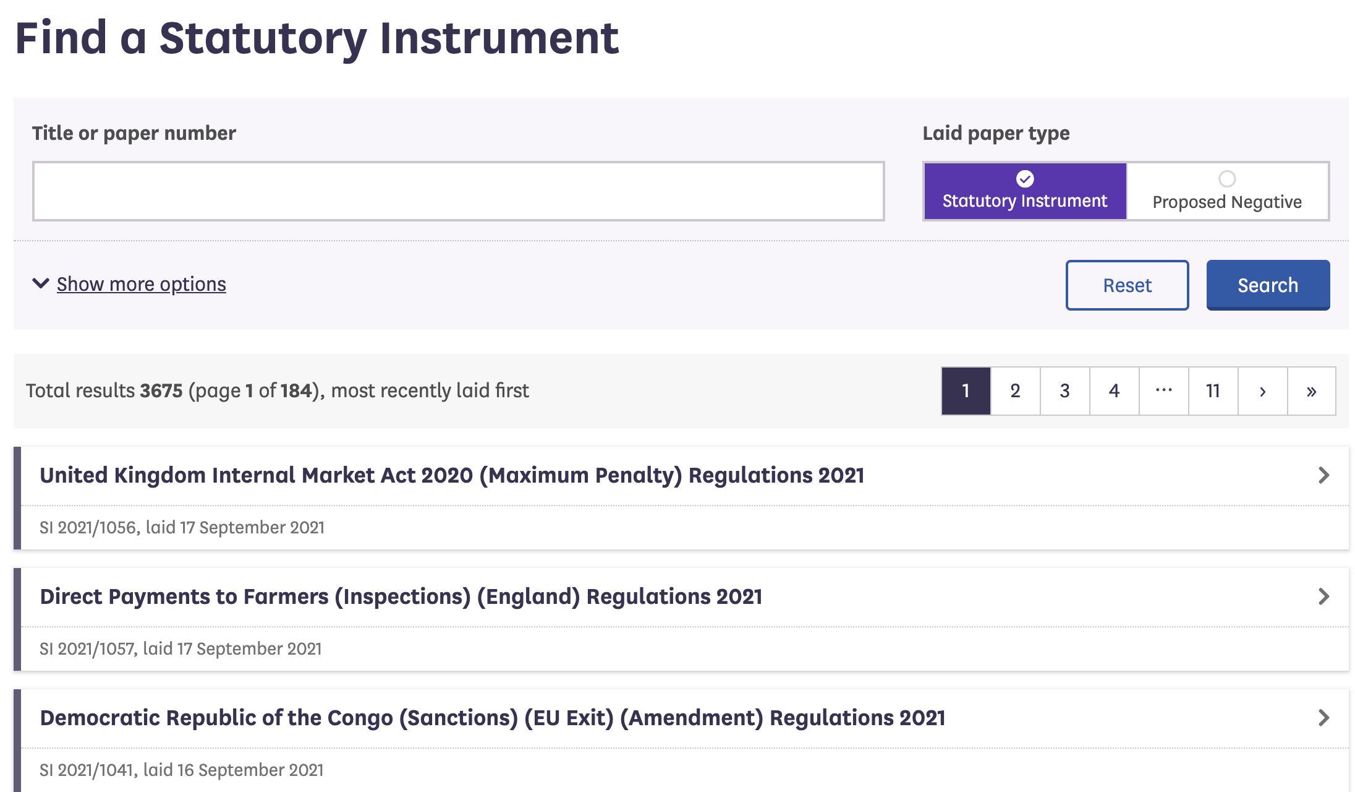

Notes:
In 2018 we were asked to make a publicly available Statutory Instrument tracking service. And we did.

Slide 4
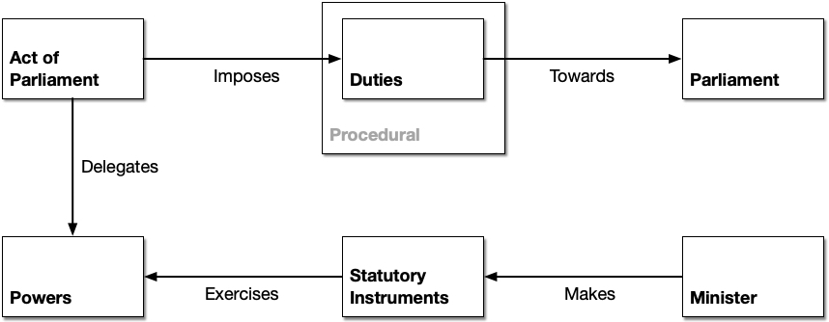
Notes:
For those new to Statutory Instruments
Acts of Parliament delegate certain powers to ministers
Ministers create secondary legislation under these powers
In the UK SIs are the most frequently used type of secondary legislation

Slide 5
The problem we were trying to solve
Notes:
The problem we needed to solve was how to reconcile information about the passage of Sis
This information is produced by lots of offices in Parliament

Slide 6
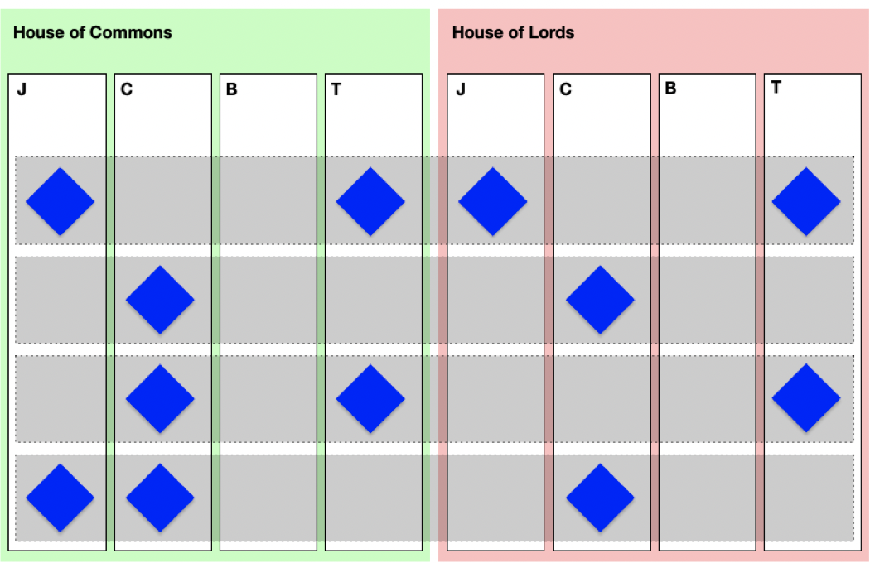
Notes:
Almost all offices in both Houses touch on SI procedure: both Journal Offices, both Table Offices and various committees
In order to track an SI one needs to track the activities of assorted committees and offices represented here.
People found it difficult to track the journey of an SI through Parliament
Even Members of Parliament and library researchers struggled

Slide 7
The importance of well-managed information
Notes:
We are information modellers and managers. We think this is an information management problem
But information management is often no-one’s job

Slide 8
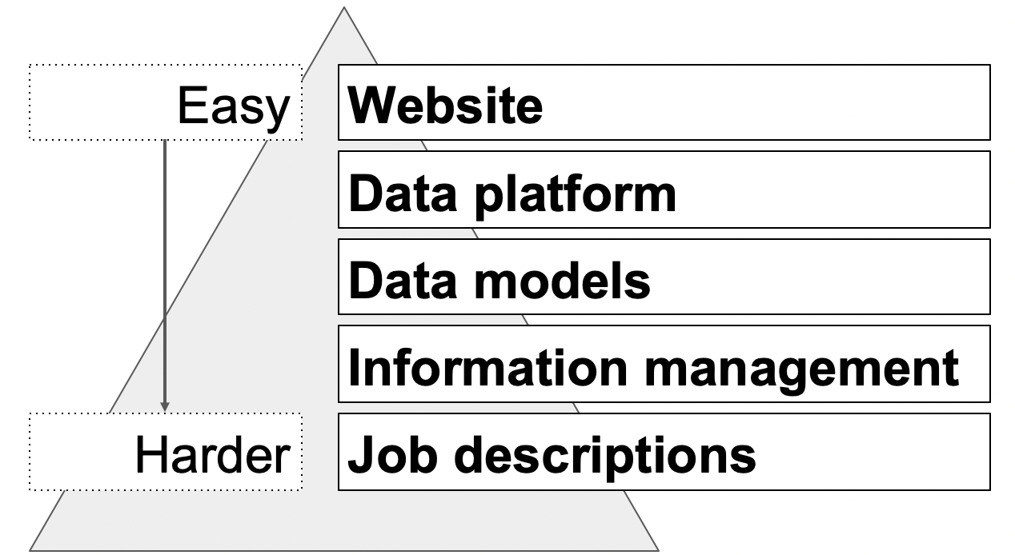
Notes:
At this point we turn to our trusty iceberg metaphor
Making websites, visualisations and querying data is relatively easy
Making a data platform and models that are as flexible as Parliament is harder
Managing the information is harder still
Managing the information when it’s not in anyone’s job description starts to get impossible

Slide 9
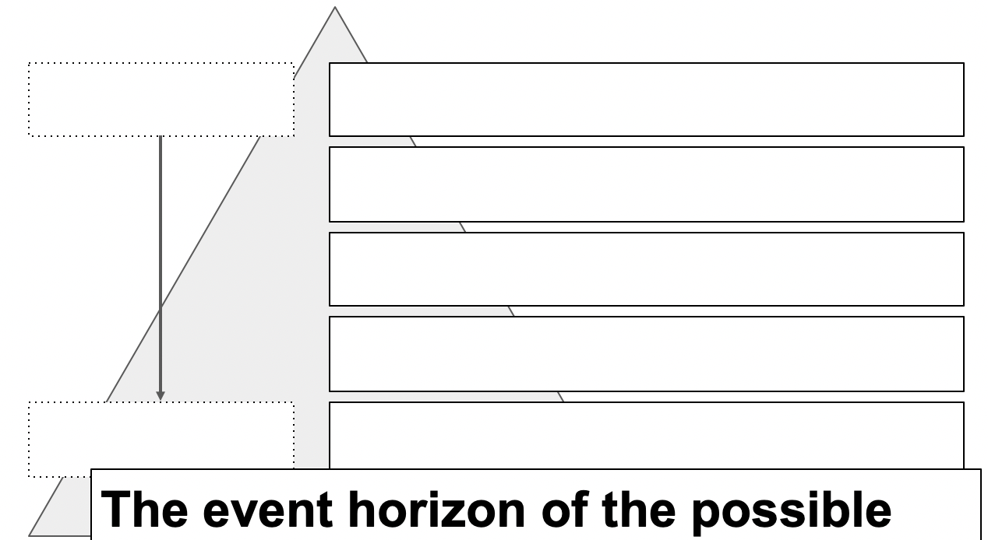
Notes:
And you pretty quickly reach the event horizon of the possible
But the problem is more than just jobs and roles

Slide 10
Your Finance Department controls your information management
Notes:
Information management is only ever as good as the tools available
How those tools are commissioned and paid for influences and constrains the shape of the data they produce

Slide 11
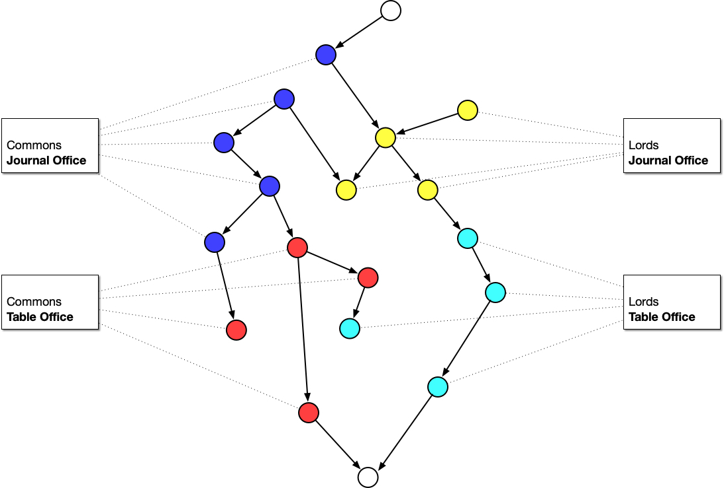
Notes:
Given each office has their own view of the things they’re interested in, we often end up commissioning tools to digitise existing office bound processes and missing out on the bigger picture

Slide 12
Binding the correct contexts
Notes:
In order to make services that meet needs outside individual offices we need to step back and look for new patterns that don’t stop at office walls

Slide 13
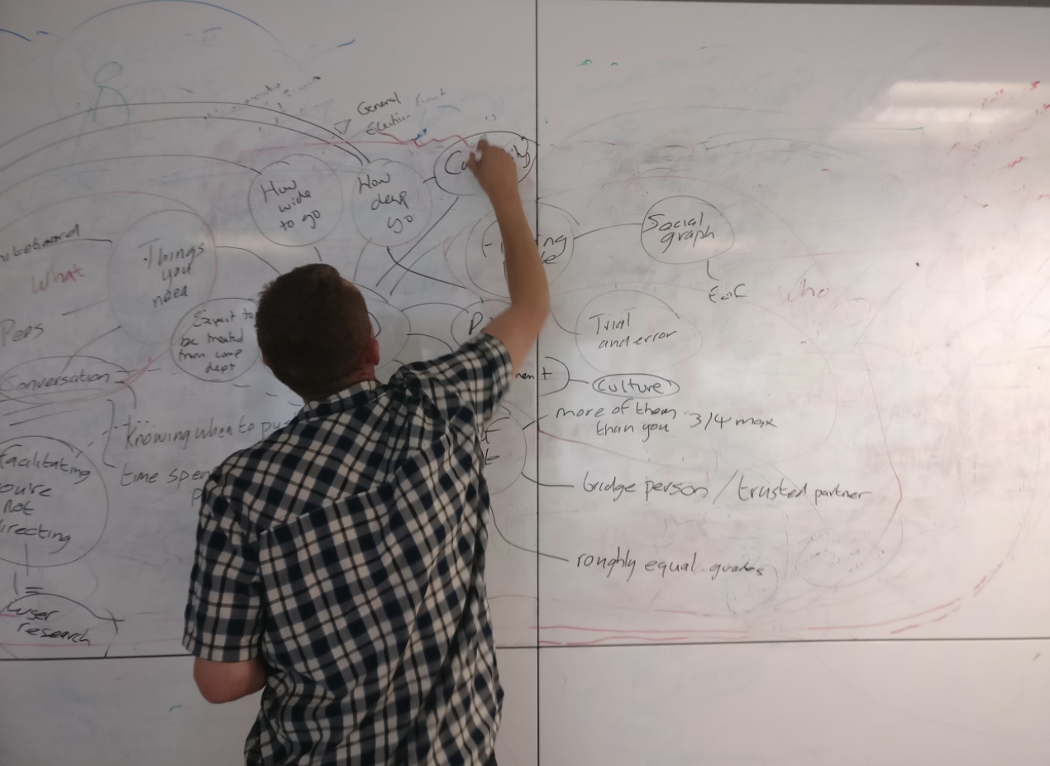
Notes:
We work with researchers, lawyers and clerks to explore the territory from as many angles as possible and use conversation and whiteboards to identify bounded contexts that make sense beyond any particular office

Slide 14
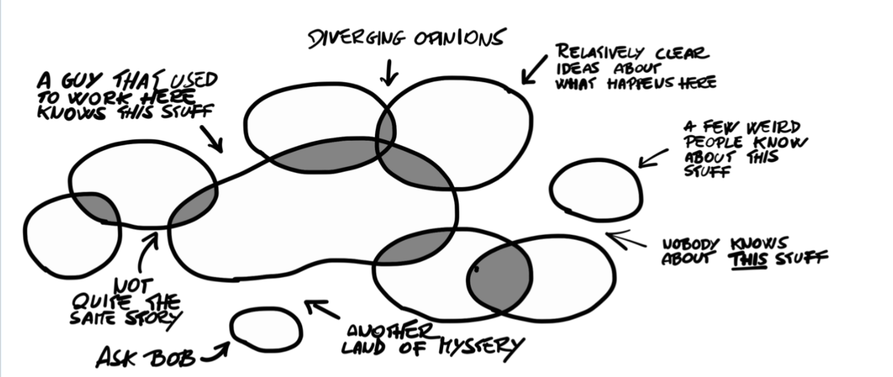
Image credit: Introducing EventStorming, Alberto Brandolini
Notes:
Because procedure is largely based on precedent, no one story can ever be taken as the whole truth

Slide 15
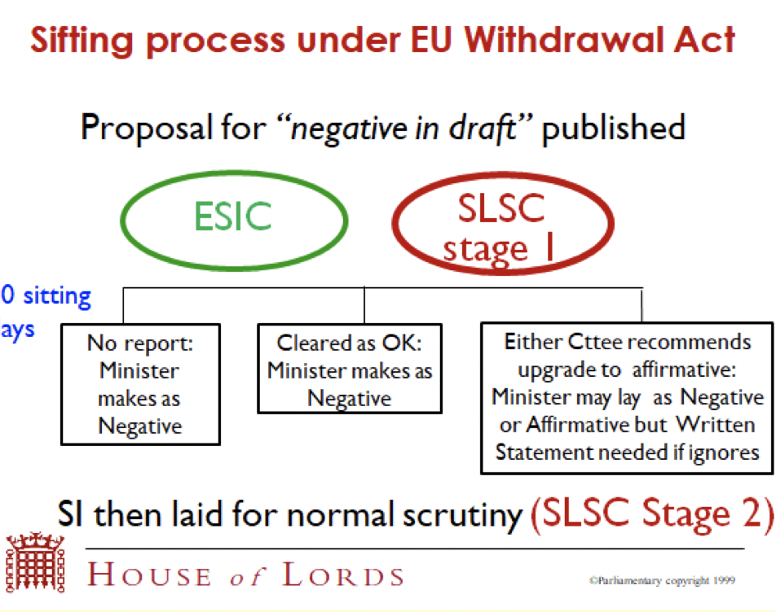
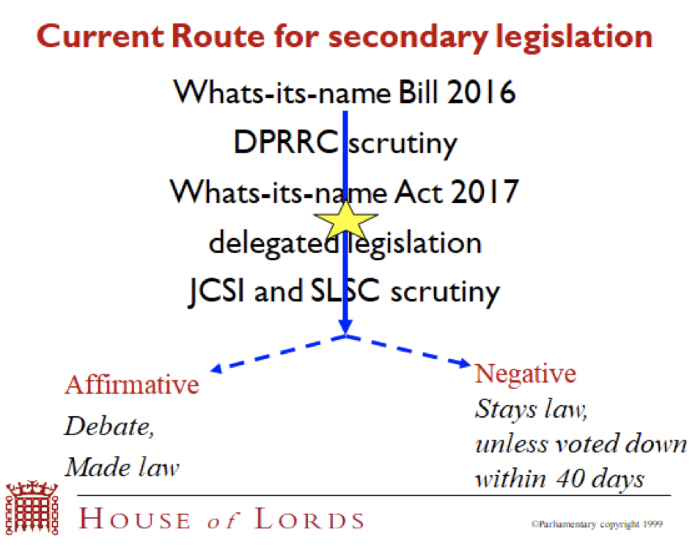
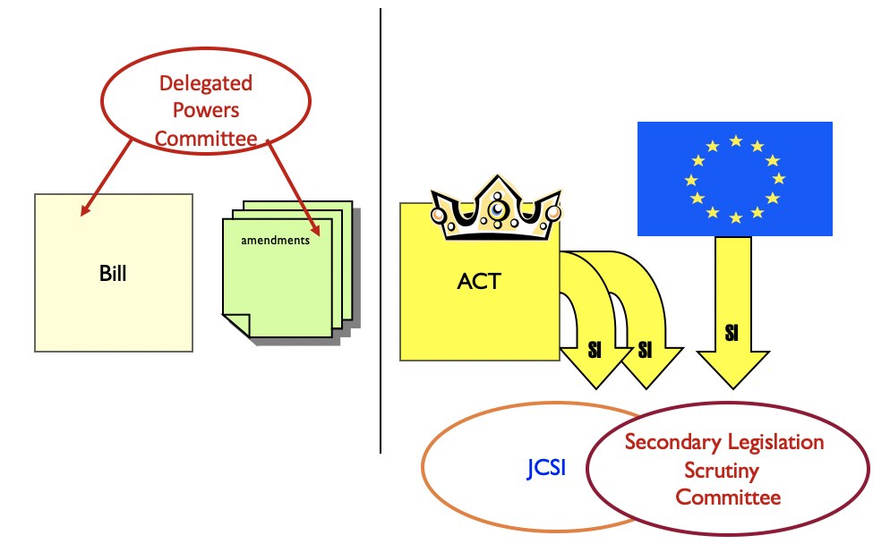
Notes:
When we first started on the SI service, everyone we met brought us a flowchart
All drawn from a certain perspective and none complete
Over several months we talked and sketched and brought together multiple perspectives

Slide 16
The procedure model
Notes:
The result was a process flow model - or, as parliamentarians might say - a procedure model

Slide 17
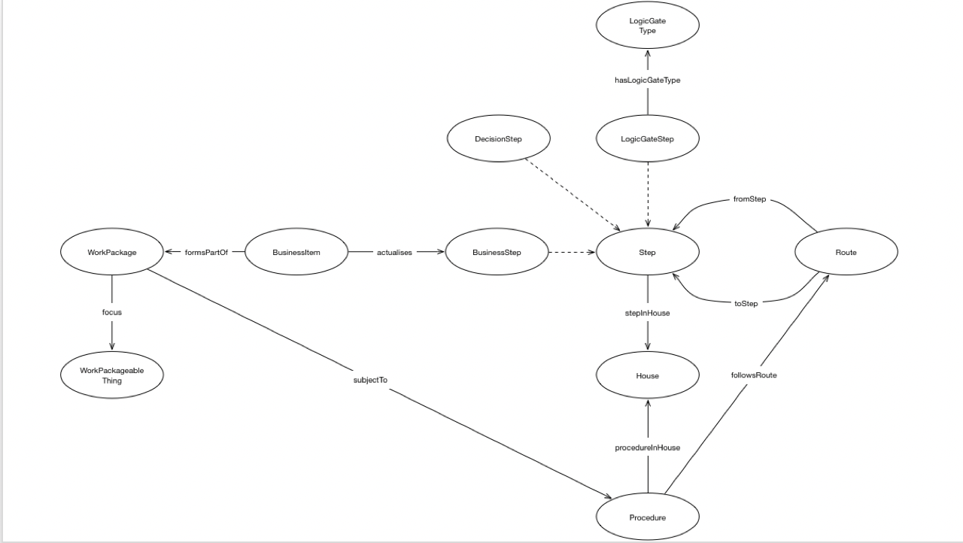
Notes:
It allows us to state that, given what has happened, what may, must and can’t happen next
A clerk would not recognise this model
It is generic, having no domain knowledge or domain language encoded

Slide 18
The maps
Notes:
Whilst the model may be generic, layered on top are procedural maps
Most of our time is spent mapping procedures on top of the model

Slide 19
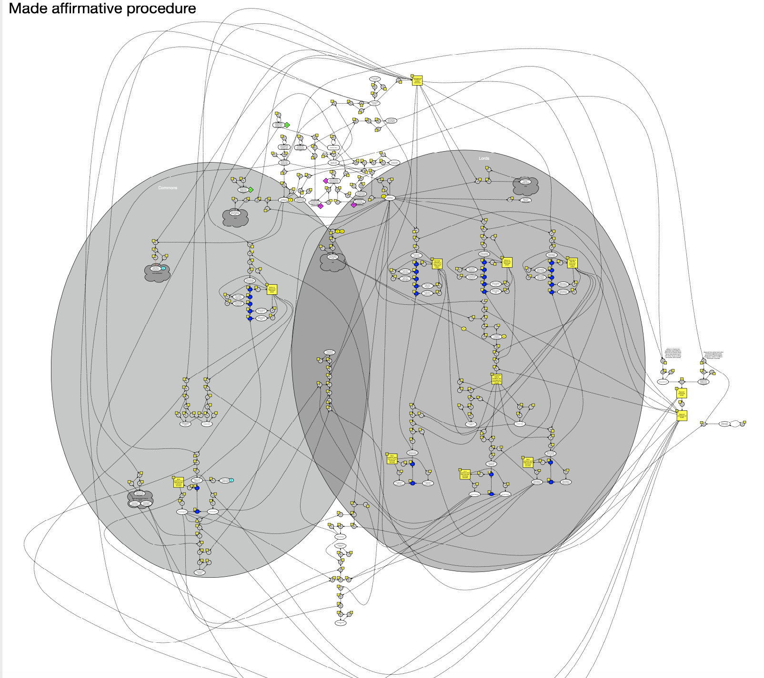
Notes:
This is an example of a procedure map, for made affirmative statutory instruments.

Slide 20
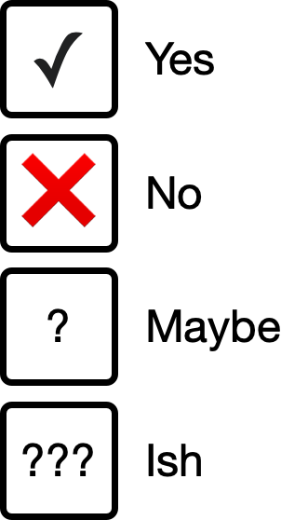
Is this Rules as Code?
Notes:
Is this Rules as Code?
Procedure is informed by several strata of what one might - perhaps mistakenly - call “rules”

Slide 21
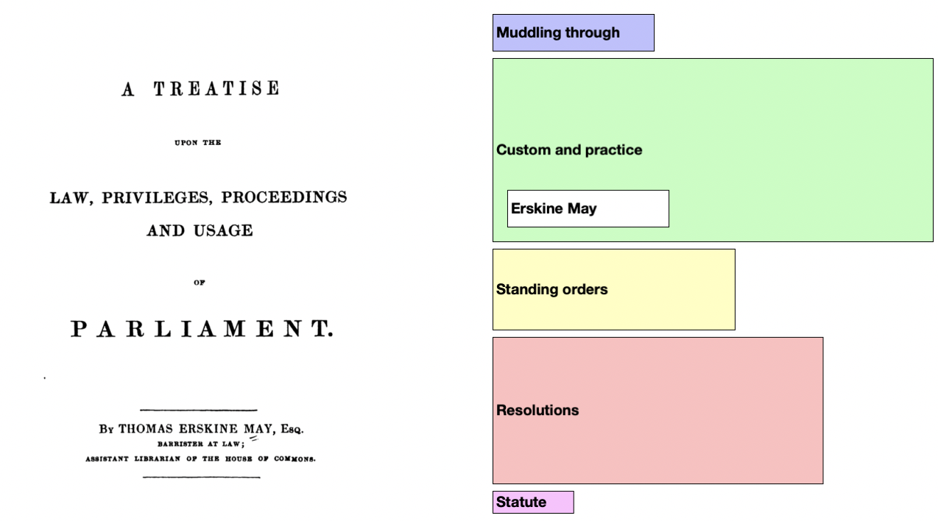
Notes:
This is a picture we stole from a retired Clerk of Committees
It shows the components that inform procedure
The further down the stack the more immutable
The wider the bar the greater the coverage
In order to map procedure we need to take account of legislation, standing orders, speaker rulings and precedence
And we also need to take account of “muddling through” because improvisation is how a lot of things work

Slide 22
Parliament is not complicated
Notes:
At this point we tend to invoke the Cynefin framework

Slide 23
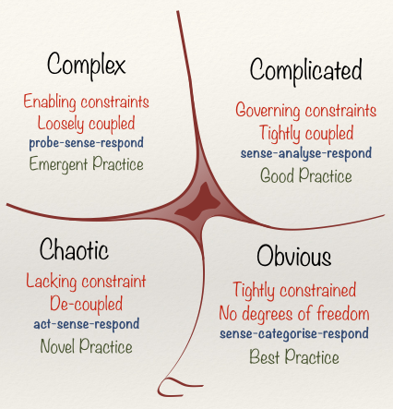
Notes:
Much software has been designed and built on the assumption that Parliament operates in a complicated space
This is not true
Parliament is a complex adaptive system
”Rules” are malleable
Tightly coupling the implementation of software and data models to defined rulesets makes the software and its resulting information brittle and liable to break under change
So whilst the procedure model can be interpreted as conservative on output, it is always liberal on input

Slide 24
The cult of user needs
Notes:
We’ve not talked about what users might need from an SI tracking service
We find that an emphasis on user needs isn’t always helpful
By concentrating on describing the domain we don’t lock ourselves into single solutions
Not only do needs differ across user groups, sometimes our users have needs that are diametrically opposed to the needs of other users
This being the nature of politics

Slide 25
So what did we build?
Notes:
So what did we build?

Slide 26
Notes:
This is the statutory instrument website that Parliament asked for
A website that can flex and adapt as Parliament flexes and adapts

Slide 27
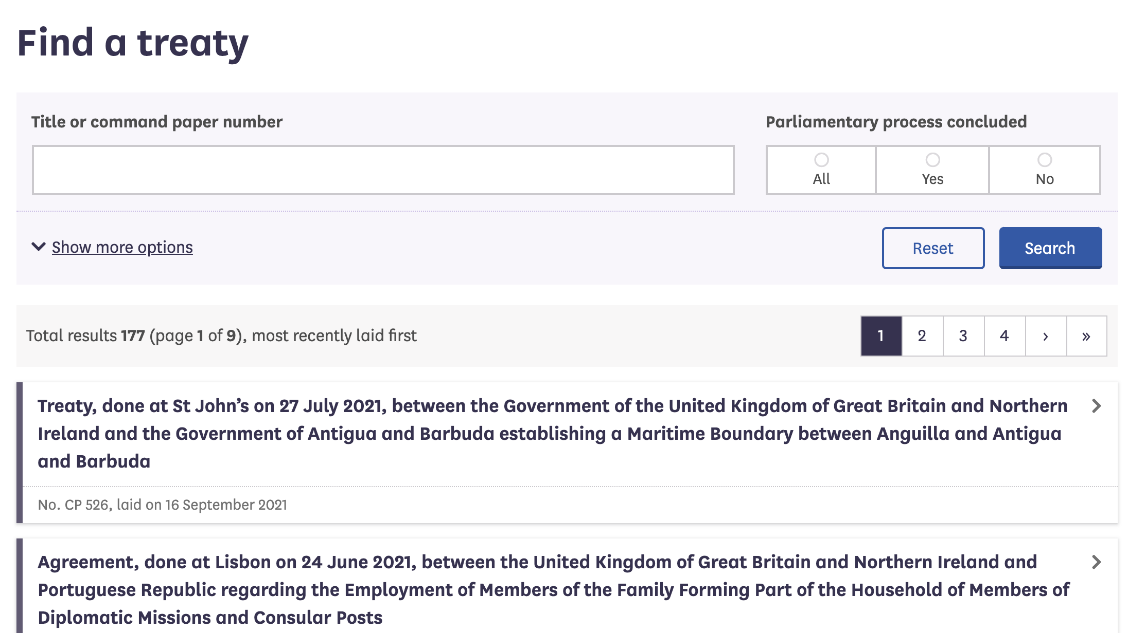
Notes:
By understanding the domain, choosing the right bounded contexts we can do more
We took the same model and – with relatively little work - overlaid a map of the procedure for treaties
And with almost no work made a website and a library of queries for treaty procedure too

Slide 28
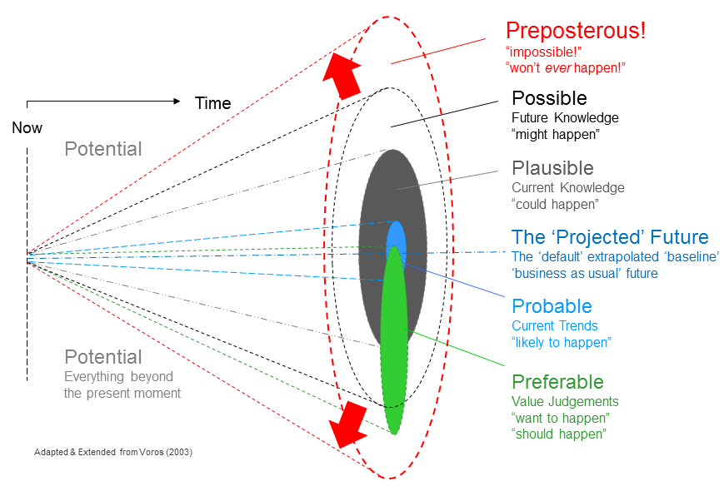
Notes:
We’ve already mentioned that the maps can be parsed by machines to determine - from what has happened - what may, must and shouldn’t happen next
We call this the light cone of procedural possibilities
We can use this data to alert Members to points at which they can intervene, for example: today is the last day you can object to this SI.

Slide 29
Querying for precedence
Notes:
If you’re a researcher, we have a pot of data we can query for precedence
Queries such as: when did X and Y both happen when Z didn’t

Slide 30
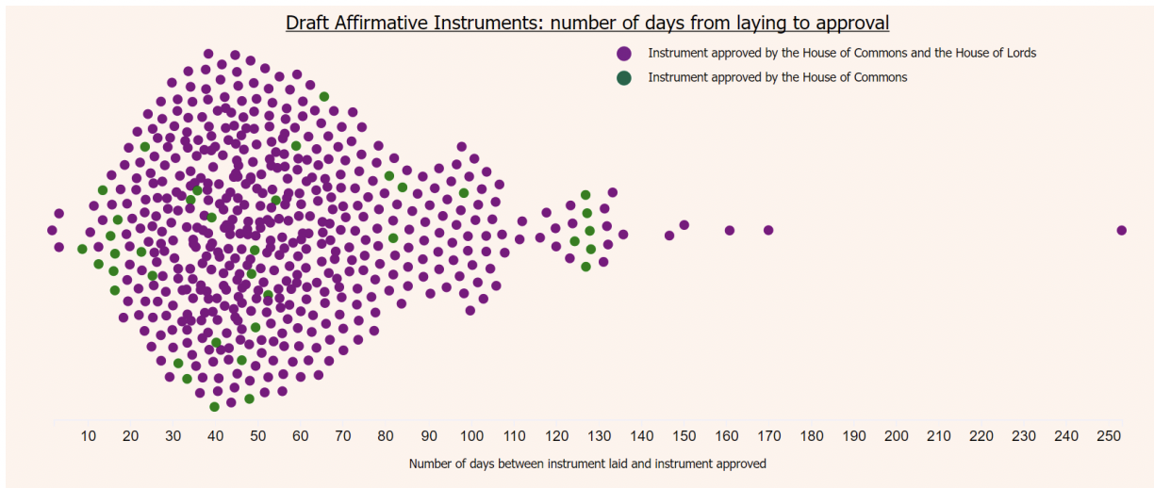
Notes:
We can use the pot of data to look for patterns
This is one example showing the number of days between laying and approval of draft affirmative instruments
More importantly, the queries are repeatable

Slide 31
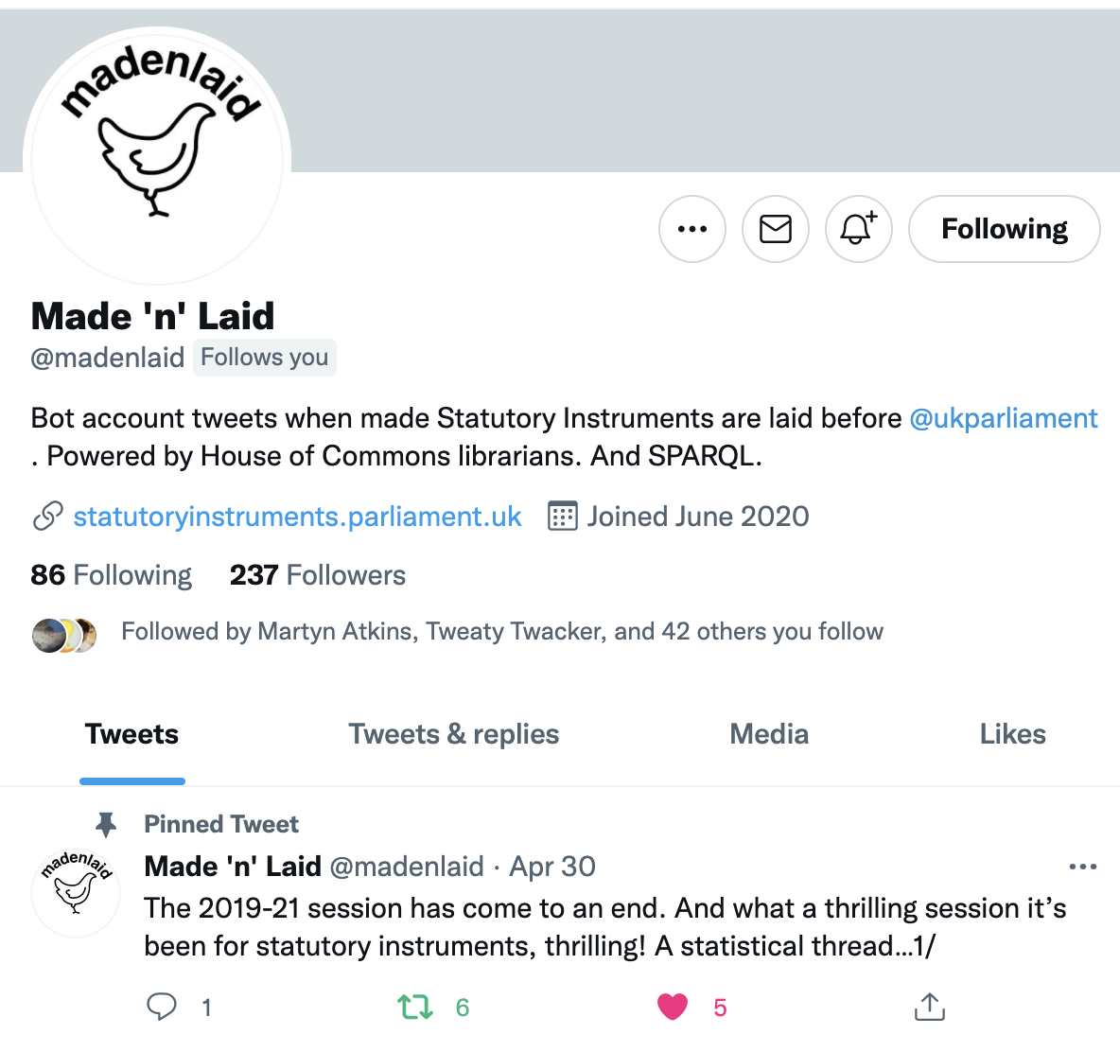
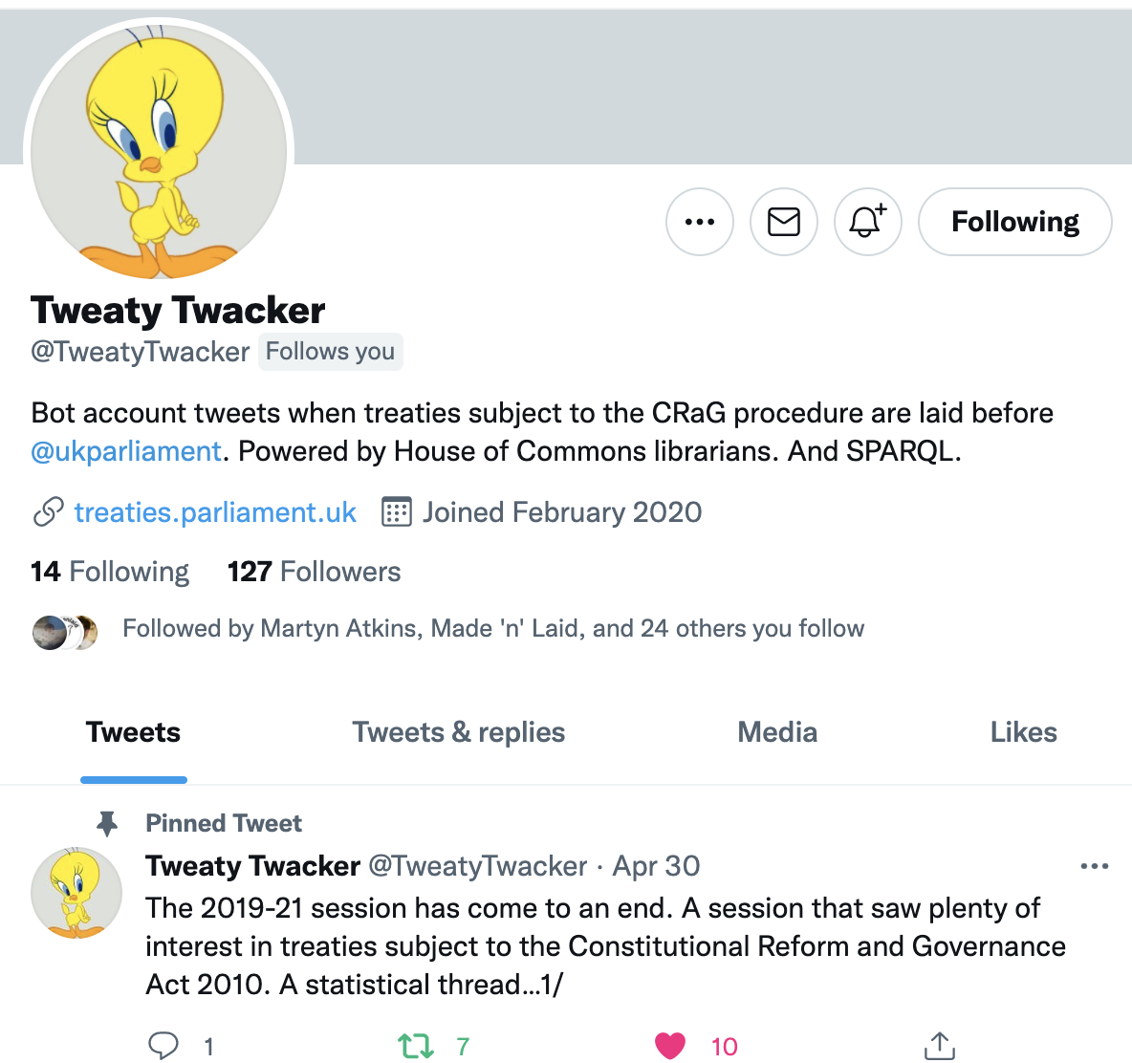
Notes:
Nobody asked for Twitter bots for SIs and treaties but a couple of hours work and we now have 237 people following avidly

Slide 32
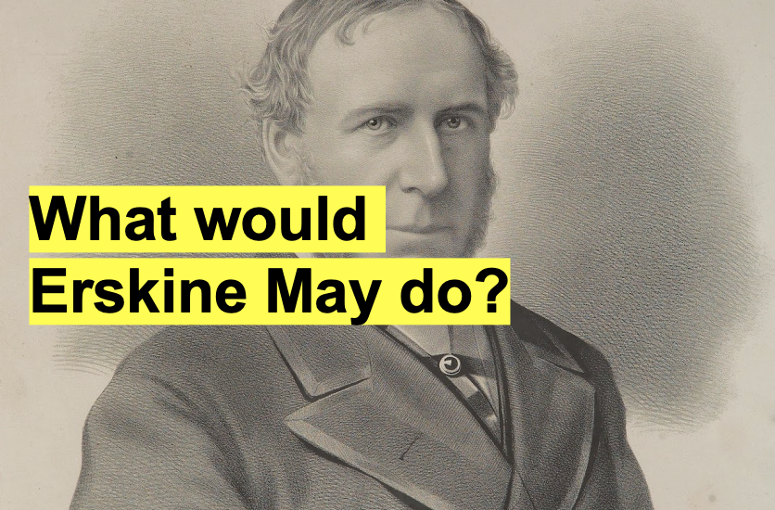
Notes:
In summary
Information management is hard work
Understanding the domain is not quick
But well modelled, well managed information is generative
Possibilities emerge when you take the time and trouble to understand the domain
We ask ourselves – if Erskine May had had a computer – what would he have done
We think possibly…
He would have used it to build a graph of knowledge of parliamentary business
And built a precedence engine out of data
Thank you

